Slide 1



Nav Gem

Slide 2

Nav Gem

Slide 3
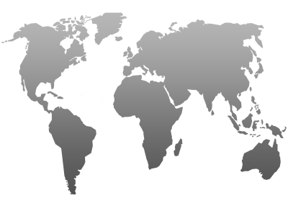
Nav Gem
Problem:
Lack of Knowledge
Solution:
Information Availability
Covid-19

Slide 4
NavIGem
Project Type: Informative application
An interactive map where users can learn information on countries and then test their knowledge with a quiz

Slide 5
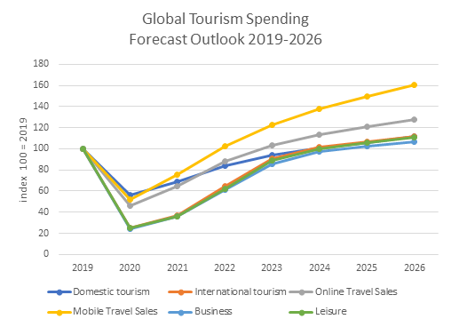


Main Target Audience: People interested in travelling to other countries
Target Audience:
NavIGem
Global Tourism Spending
Target Audience:
Main Target Audience: People interested in travelling to other countries
Forecast Outlook 2019-2026
180
Index 100 = 2019
160
People that can benefit: Students, Teachers, people interested in other countries
People that can benefit: Students, Teachers, people interested in other countries
140
100
120
60
80
0
40
2019 2020 2021 2022 2023 2024 2025 2026
Market Analysis
20

Slide 6
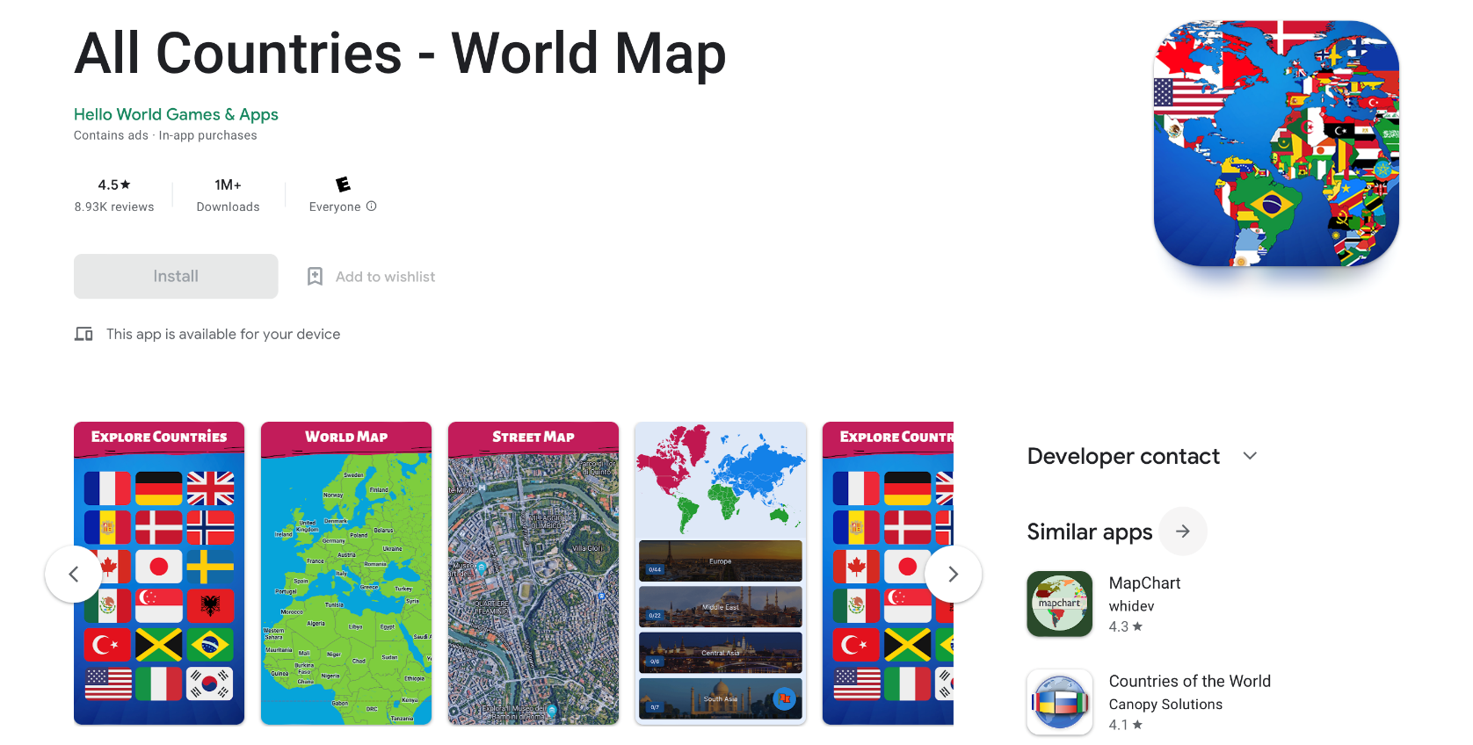
Main Target Audience: People interested in travelling to other countries
Target Audience:
Market Analysis
Global Tourism Spending
Forecast Outlook 2019-2026
180
160
140
Index 100 = 2019
People that can benefit: Students, Teachers, people interested in other countries
120
100
80
60
40
20
0
2019 2020 2021 2022 2023 2024 2025 2026

Slide 7
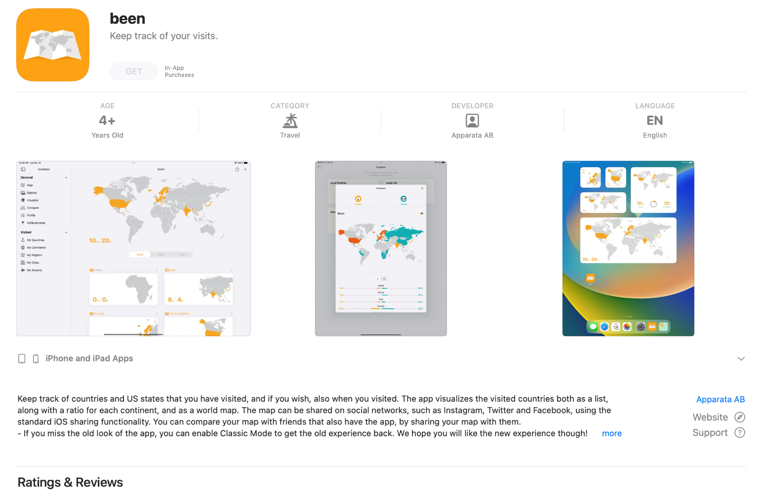
App Analysis

Slide 8
Project Scope
Interactive world map : tourism
Allow users to learn about other countries
Quiz
Information displayed in a minimalistic and easy to understand way

Slide 9
Project Message
The aim of our web program is to educate in an engaging way
Allow users to learn which countries are in which parts of the world
Educate users by presenting facts and statistics about each countries
Display information to users aesthetically
Project Scope
Tunnel
01
Tunnel visioning on popular tourist destination
Explore
02
Explore the hidden gems around the world
Learn about
03
Learn about lesser-known countries and cultures
Interactive world map : tourism
Allow users to learn about other countries
Quiz
Information displayed in a minimalistic and easy to understand way

Slide 10
Project Synopsis
The aim of our web program is to educate in an engaging way
Allow users to learn which countries are in which parts of the world
Educate users by presenting facts and statistics about each countries
Display information to users aesthetically

Slide 11
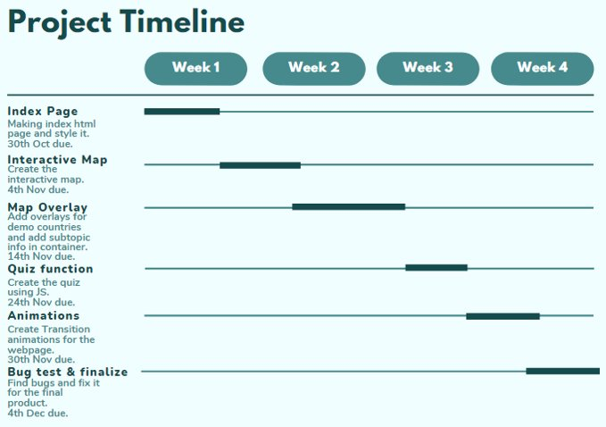
Estimated Project Timeline

Slide 12
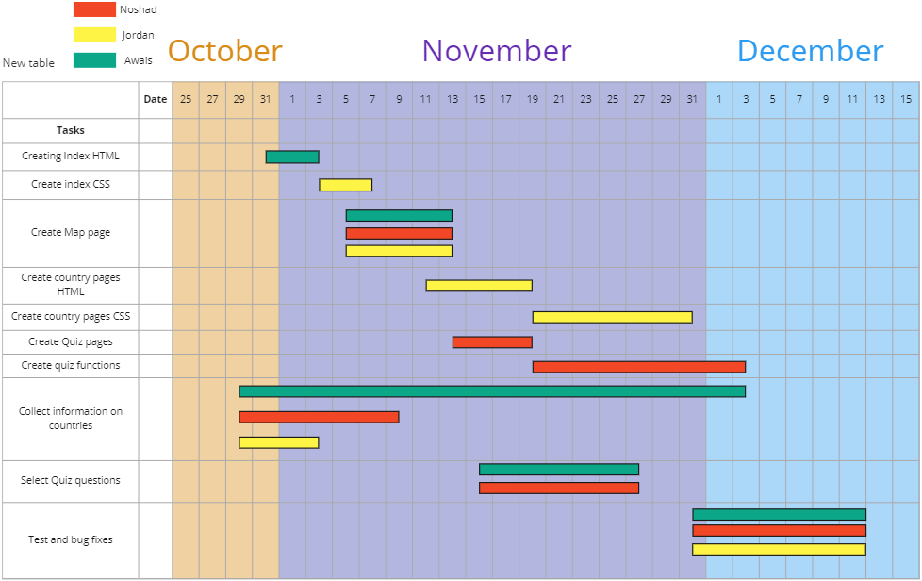
Actual Project Timeline

Slide 13
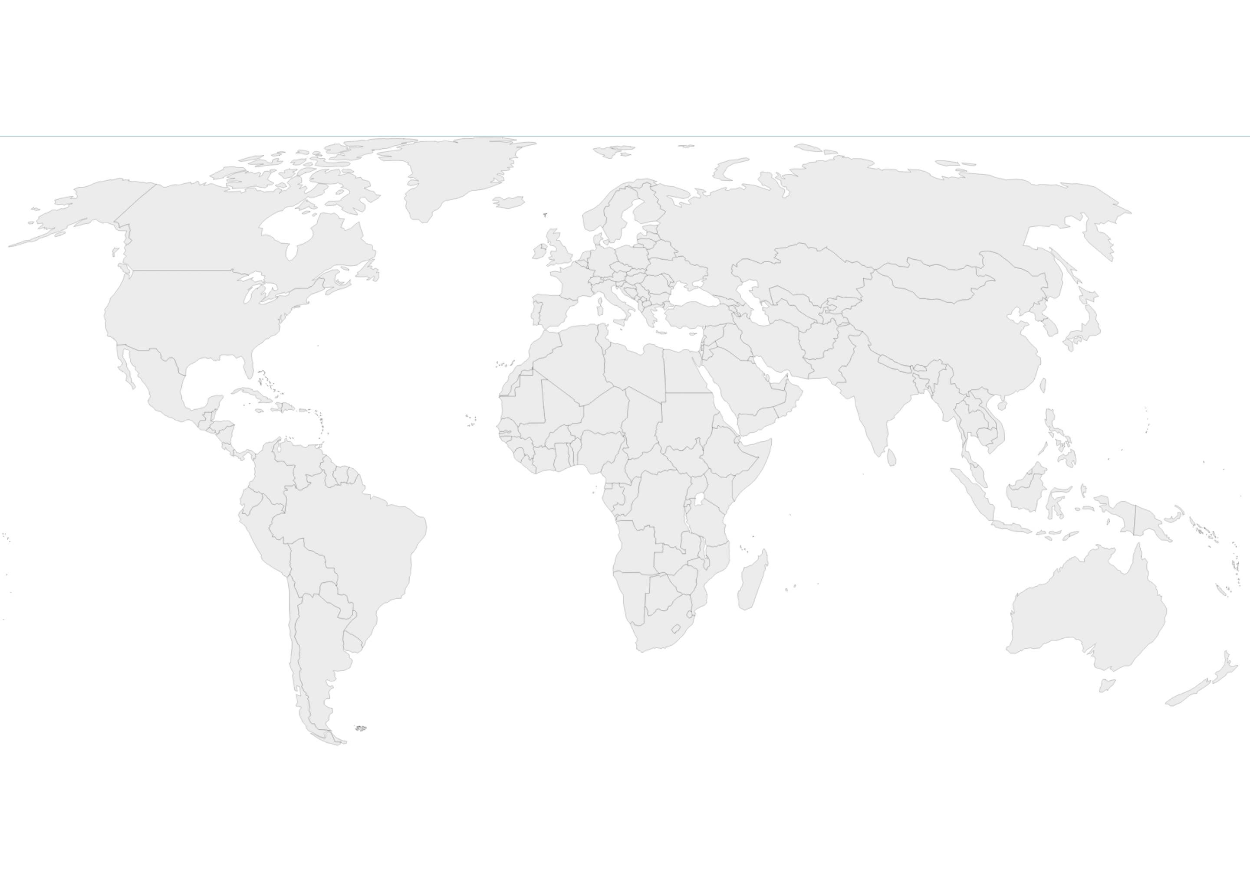
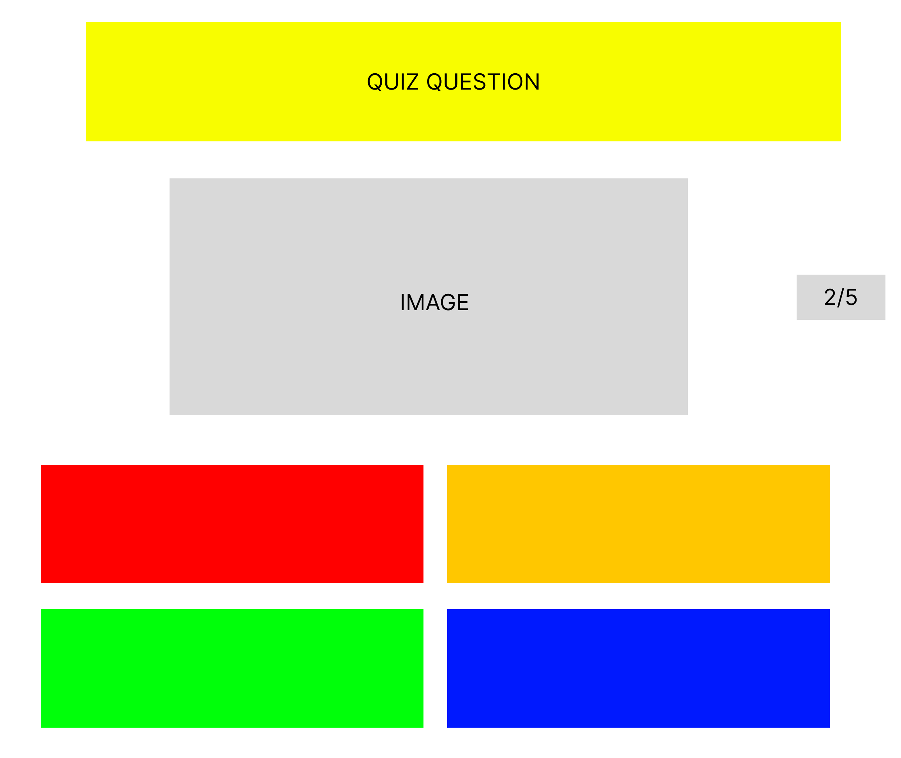
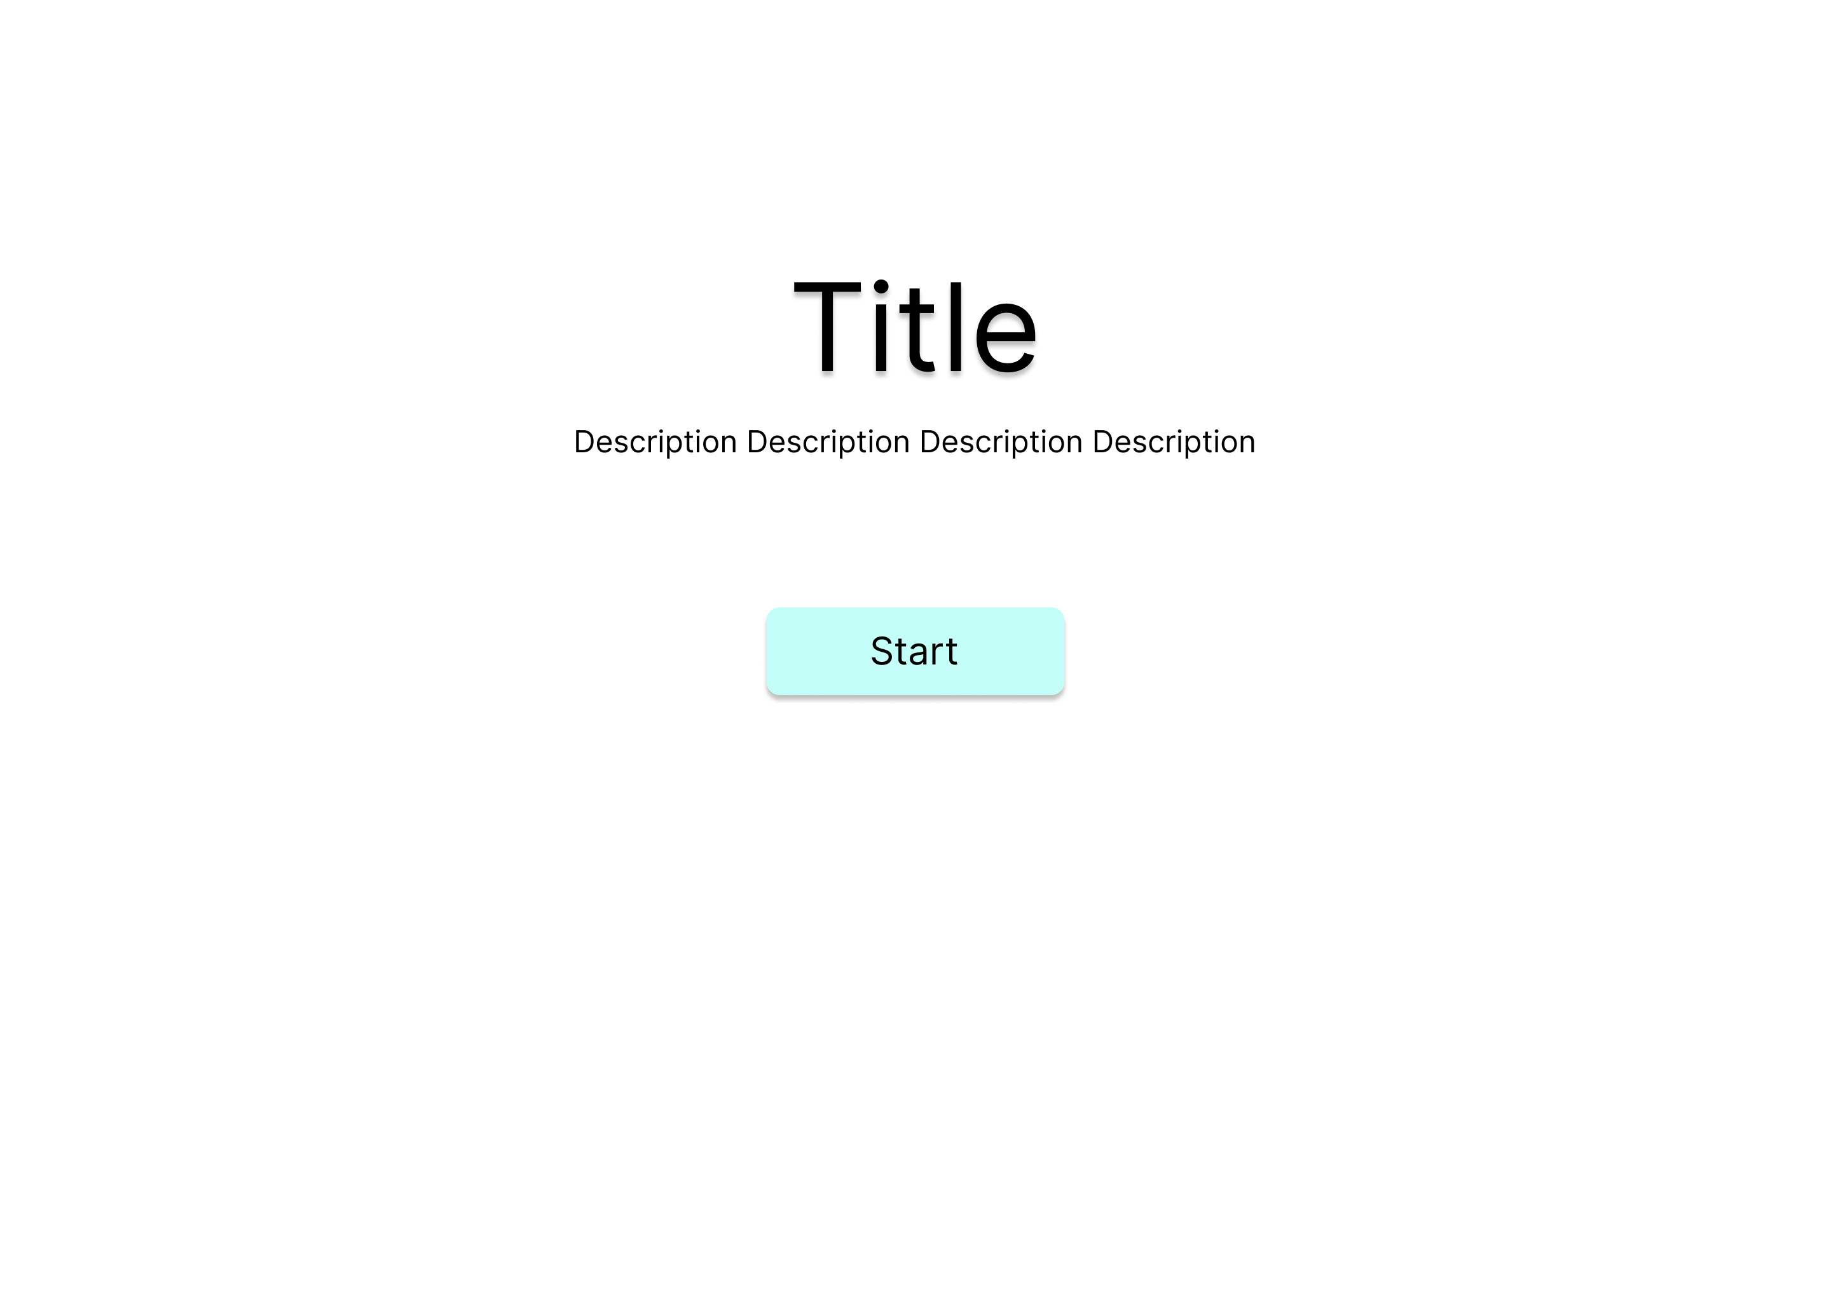
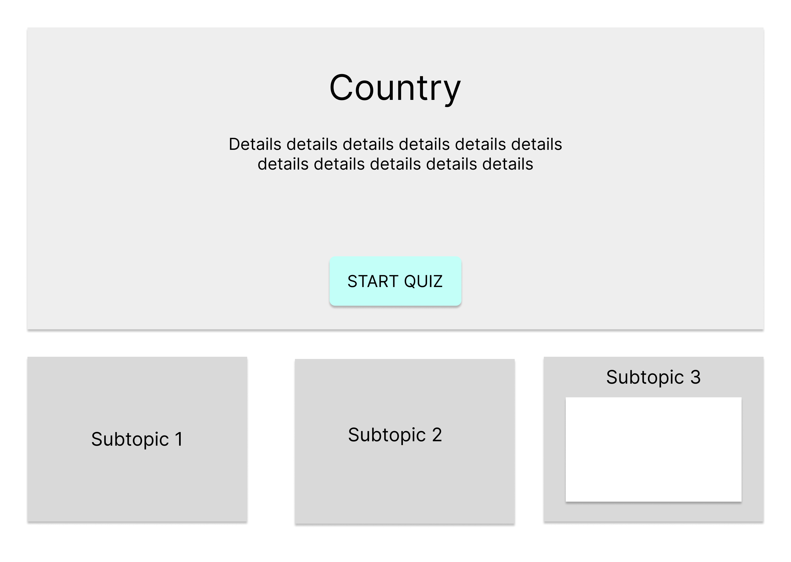
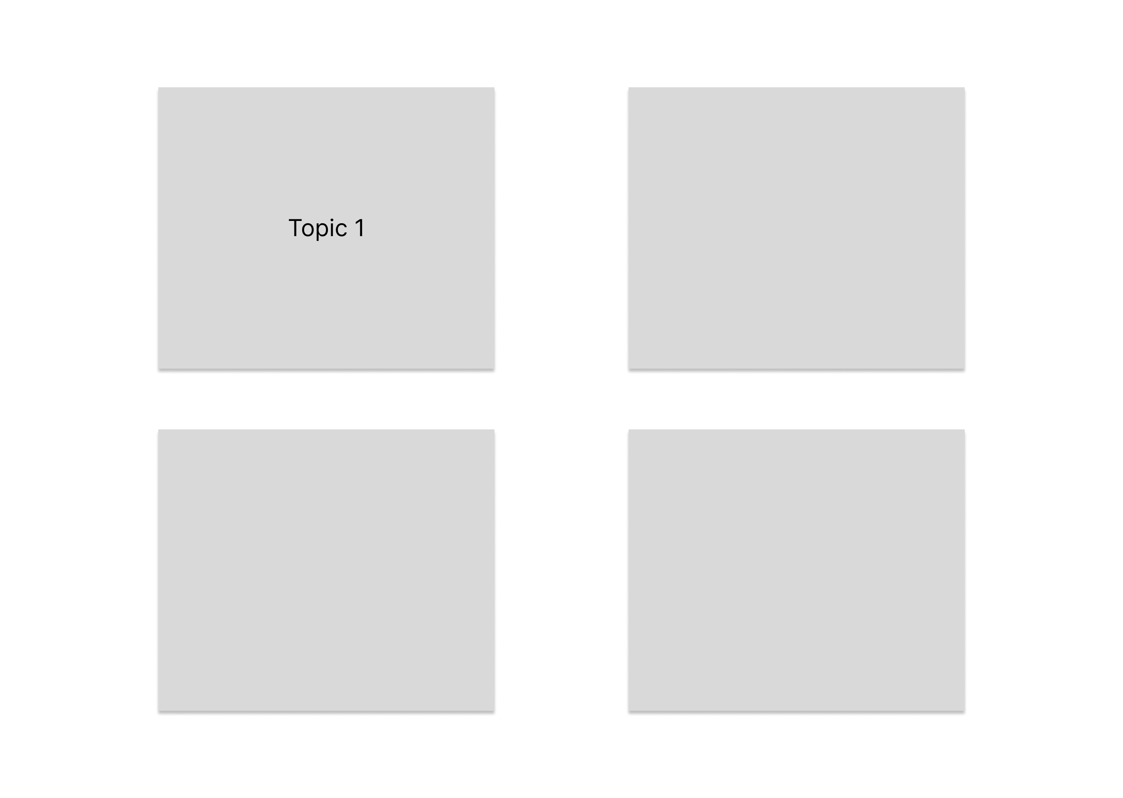
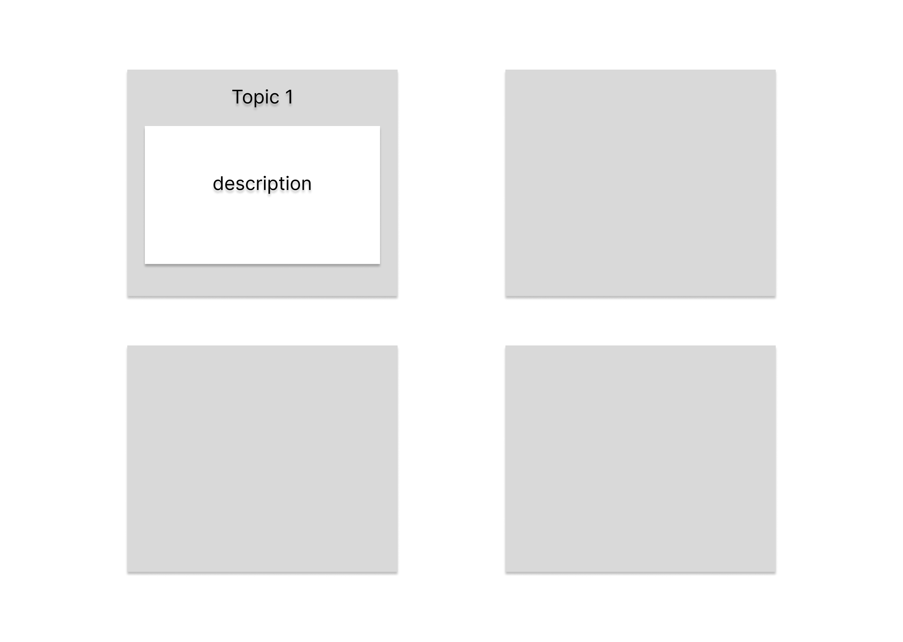
Low-fi prototype

Slide 14
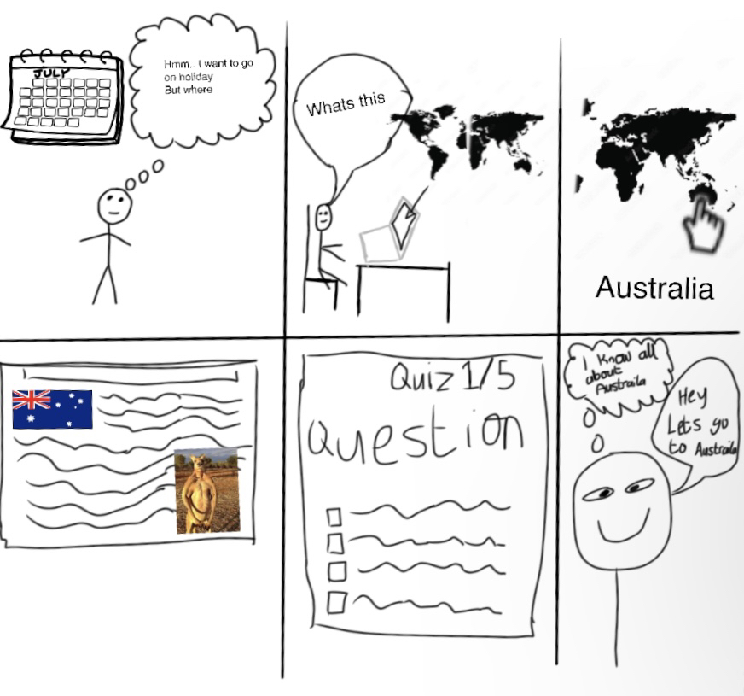
Storyboard

Slide 15
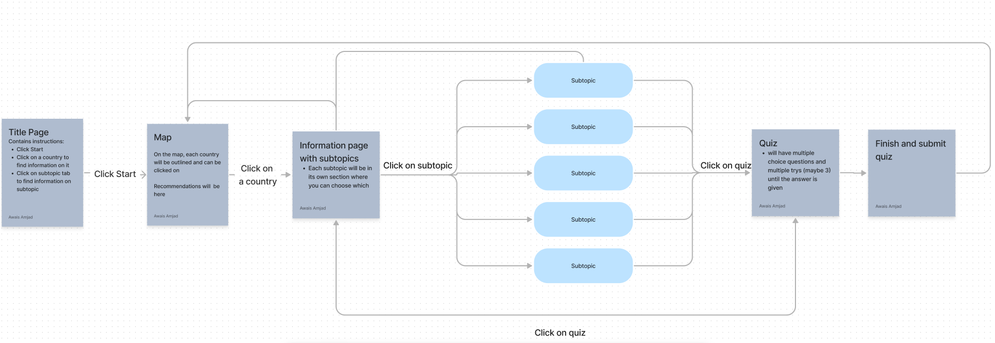
FlowChart

Slide 16
Script
Name
Questions
Users choice
Options
Submit Button
Next button
Prev button
Score
Variable name
Questions
userChoice
option(a-d)
check
next
Prev
score
Type
Object
Var
Constant
Button
Button
Button
var
Purpose
Store questions about the country
Store the users choice
Store each option box and style
Store the submit button
Store the next button
Store the prev button
Store users score

Slide 17
How we implemented the Index Page
We drew up a concept of the homepage of our website, complete with a background picture slideshow and a button leading to the map page. When the cursor hovers over a button, the text is animated to appear underlined. For inspiration, we looked up other homepage designs and modified our own. The backdrop slideshow, button, and hover animation are all part of the final design. It directs users to the map page and is user-friendly.

Slide 18
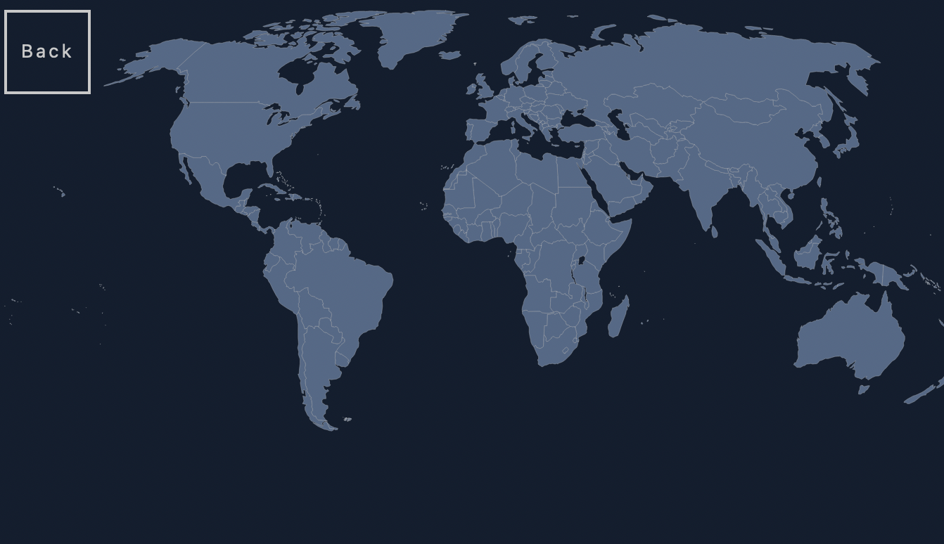
How we implemented the Map Page
We researched how to make an interactive map that allowed us to click on any countries
We then found an SVG map
We the fit it to scale and styled it

Slide 19

How we implemented the Country Pages
A webpage was made and separated into sections, which were then divided into subtopics.
To effectively present the content, we then made each segment the size of the screen and included a snap scroll feature.
To store and display information, we included some container carousels and card sliders.
We added a nav bar to make it easier to navigate and included a page to enter the quiz

Slide 20
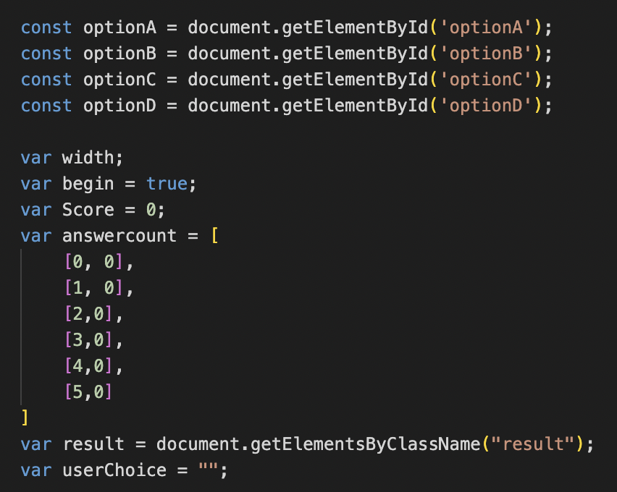
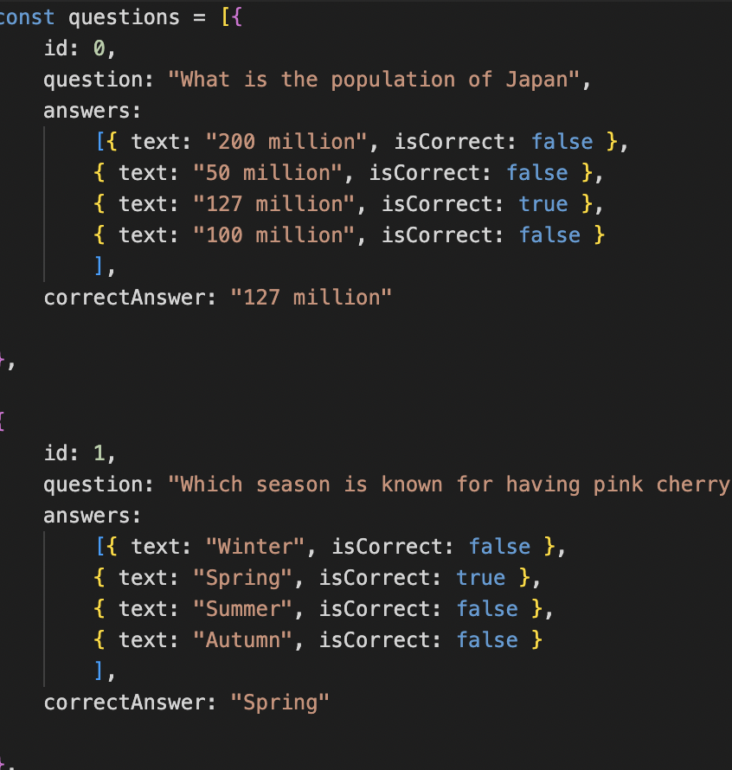
How we implemented the Quiz Page and Functions
We create a questions object to store the questions for each quiz, the object stored each question, option and answer.
With a Submit next and previous button
The style of each option was reimplemented when the user clicked the next button, previous button
The users answer was stored in a 2d array for each question to make sure the user was not able to answer the same question twice and get score

Slide 21
How we collected info on countries
We conducted web research on many nations to learn some fundamental facts about them, such as population, location, etc. Next, we looked up information from travelers on travel websites and saw . Then, we selected our main subjects: Location, Transportation, Costs, Customs, Climate, Attractions, and Food.

Slide 22
Test and Bug fixes
We tested functions to see if they worked accurately
We tested by doing personas to see if there were any bugs and by letting other people use the website
We asked friends and family to give nay feedback and then we acted on it

Slide 23
Roles
Ui/Ux designer
Awais –index pages and information collection
Coders
Jordan – information page designing
Noshad – Quiz creation

Slide 24
References
https://www.japan-guide.com/e/e2359_001.html https://www.lonelyplanet.com/articles/getting-around-japan https://www.planetware.com/tourist-attractions/italy-i.htm https://codepen.io/falldowngoboone/pen/PwzPYv https://simplemaps.com/resources/svg-world

